Slide 1

Things that I would neve do

Slide 2
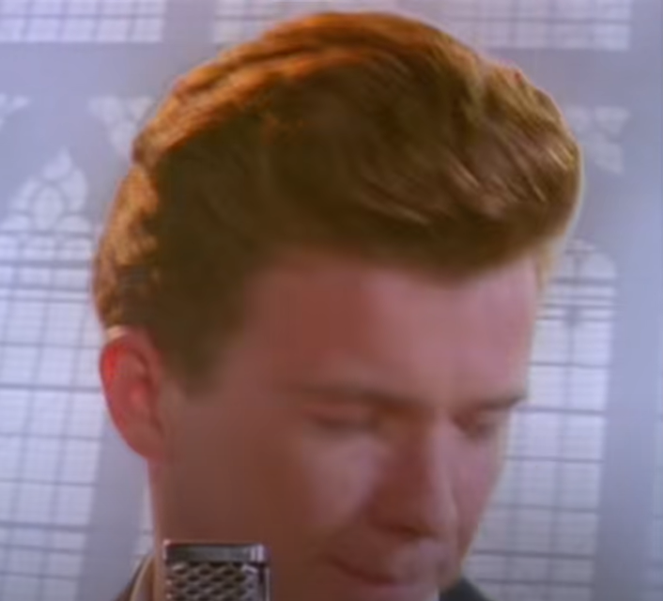
Give you up

Slide 3
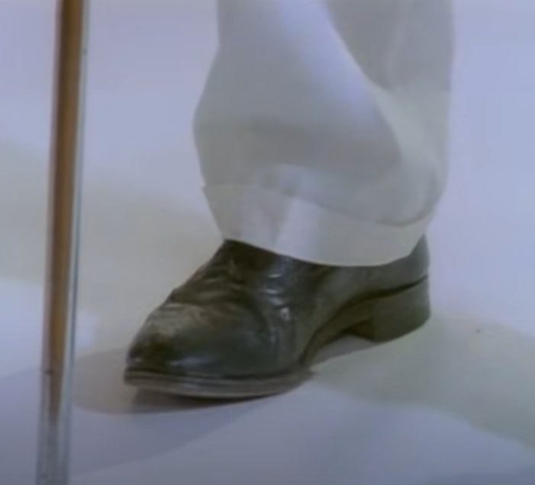
Let you down

Slide 4
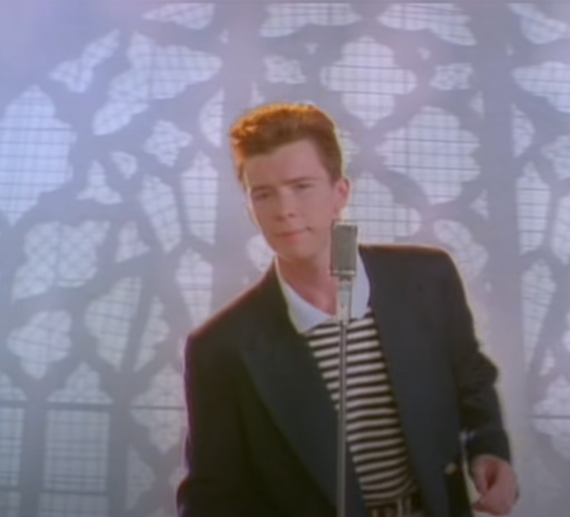
Run around and desert you

Slide 5
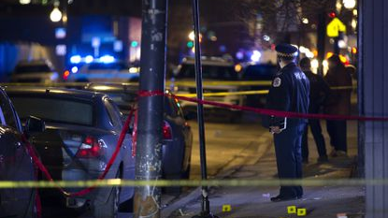
Assasinate a famous political figure in kosovo to foment ethnic tentions in the balkans
If the national authorities call about this I hope you’ll tell them that it’s something I’d never do okey.

Slide 6
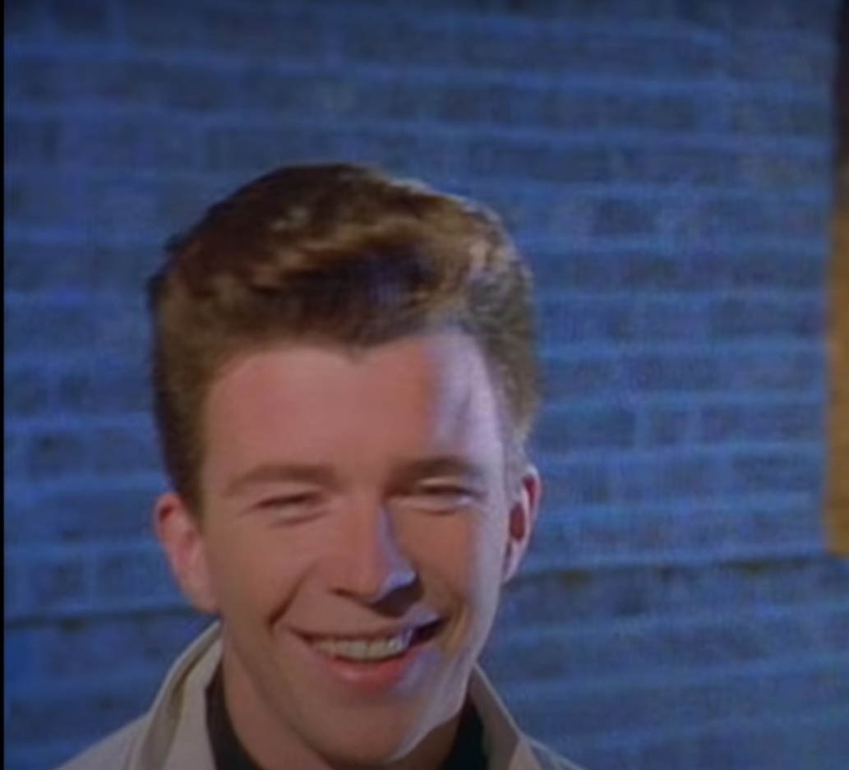
Make you cry

Slide 7
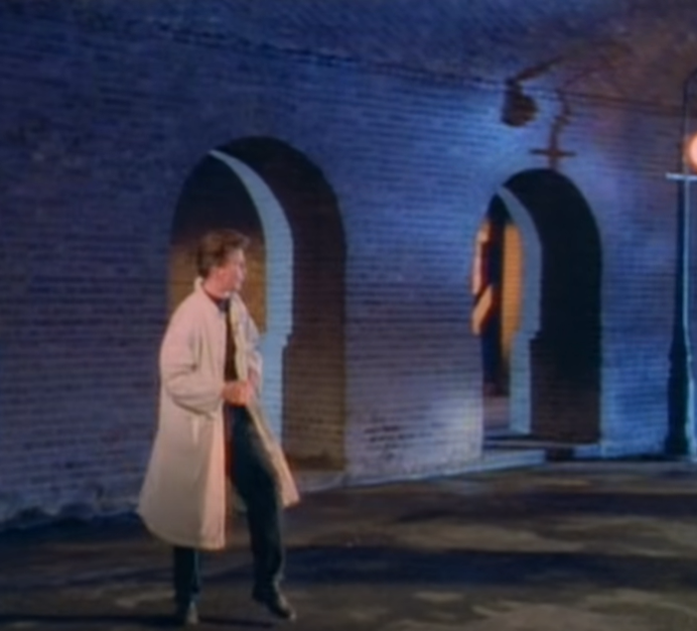
Tell a lie and hurt you

Slide 8
That was my pp
And remeber I’d never do it. Must have been the croats.

